Slide 1

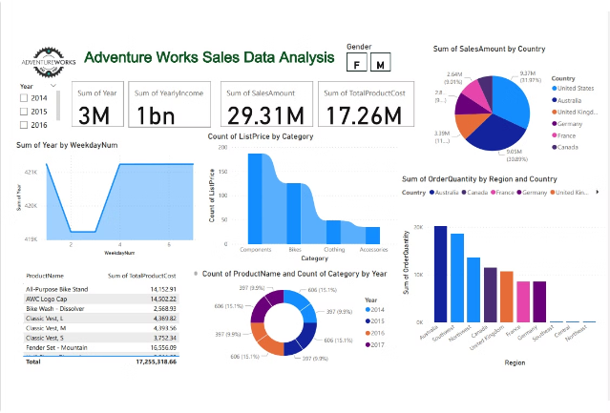

Adventure Works Sales Data Analysis
Dive into the comprehensive sales data from Adventure Works to uncover insights and trends that can drive strategic decision-making.

Slide 2
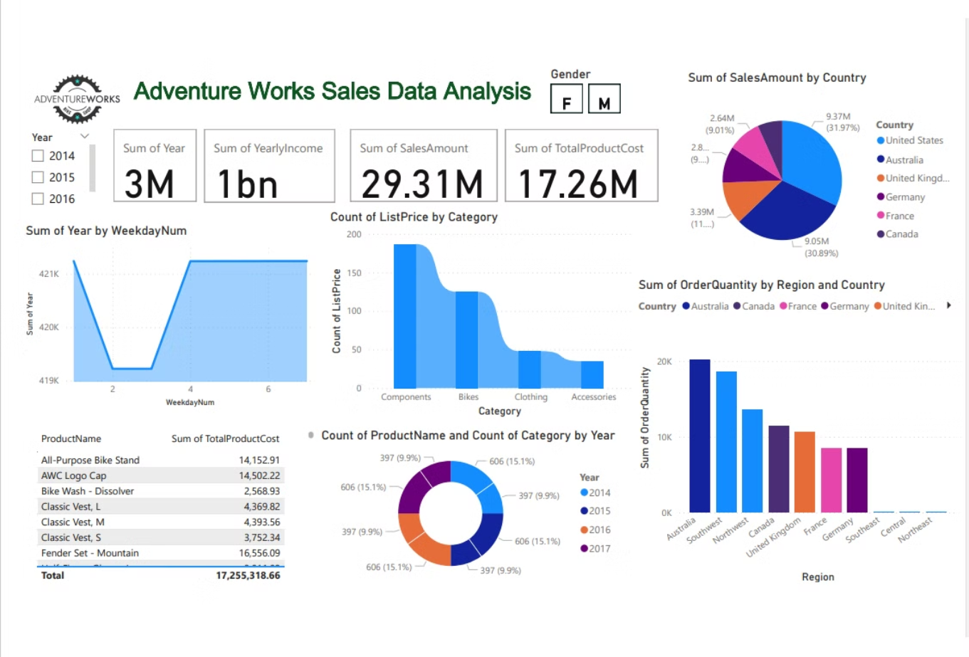

Slide 3

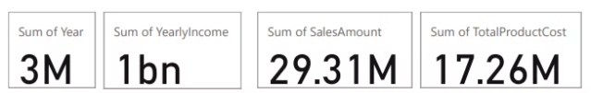
Product Sales Breakdown
1
Top Selling Products
All-Purpose Bike Stand, Fender Set - Mountain, and AWC Logo Cap are the top 3 best-selling products.
2
Product Costs
The total product cost for the top selling items ranges from $2,568 to $16,556.

Slide 4

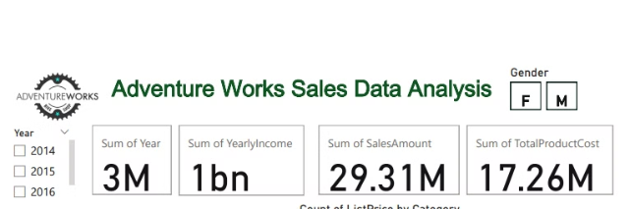
Sales Trends by Year
1
2014
Sales and product costs were relatively low this year.
2
2015
Significant increase in sales and product costs compared to 2014.
3
2016
Continued growth in sales and product costs from the previous year.

Slide 5
Sales by Region and Country
Top Regions
Sales by Gender
Power BI Insights
The top regions by sales are Australia, Canada, France, Germany, and the United Kingdom.
Sales are split fairly evenly between male and female customers across the regions.
Power BI Desktop sales were $29.31M, while Adventure Works sales were $17.26M.

Slide 6


Product Catalog Overview
1
Diverse Offerings
The product catalog includes a wide range of items, from apparel and accessories to bike components.
2
Consistent Pricing
The list prices for the products are relatively consistent, with most falling within a similar range.
3
Inventory Insights
The data provides a detailed breakdown of the product quantities and costs.

Slide 7

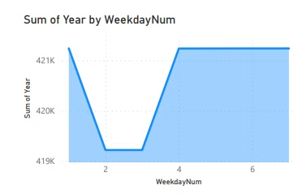
Sales by Weekday
Peak Days
Sales tend to be highest on Fridays and Saturdays, indicating a preference for weekend shopping.
Slower Days
Mondays and Tuesdays see the lowest sales, suggesting a slower start to the week.
Balanced Weekdays
Wednesday through Friday show a more consistent level of sales activity.

Slide 8
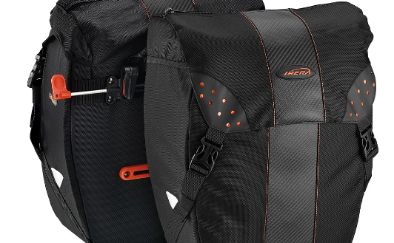
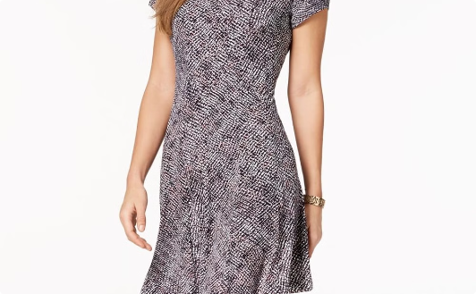
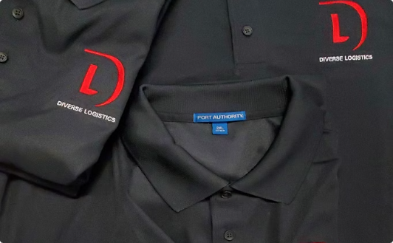
Product Category Trends
Bike Accessories
Apparel
Logo Merchandise
The Fender Set - Mountain and other bike accessories are among the top-selling products.
The Classic Vest line in various sizes is a popular apparel offering.
The AWC Logo Cap is a strong seller in the logo merchandise category.

Slide 9

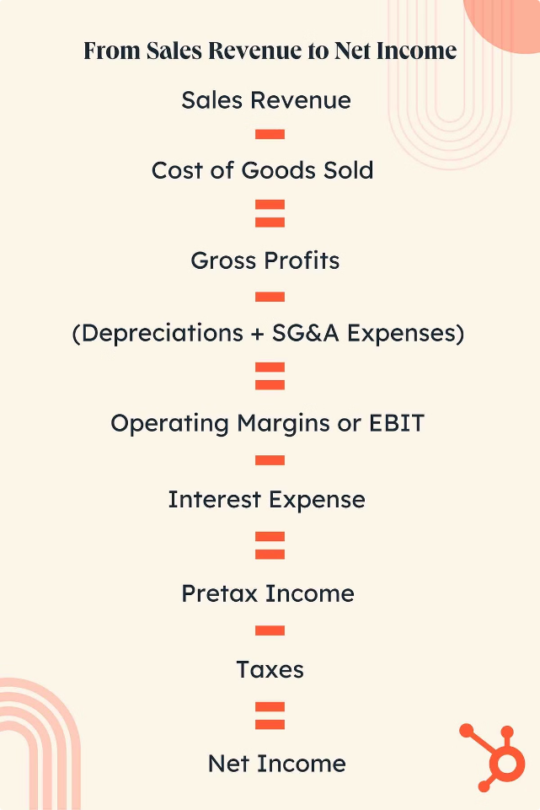



Sales by Income Level
2014
Sales and yearly income were relatively low this year.
2015
Significant increases in both sales and yearly income compared to 2014.
2016
Continued growth in sales and yearly income from the previous year.

Slide 10

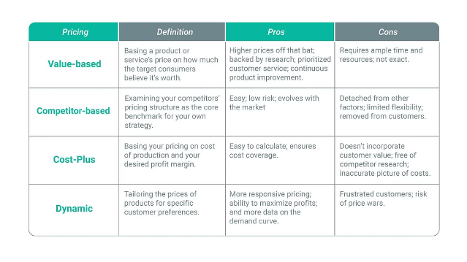
Product Pricing Insights
Product
Total Product Cost
All-Purpose Bike Stand
$14,152.91
AWC Logo Cap
$14,502.22
Bike Wash - Dissolver
$2,568.93
Classic Vest, L
$4,369.82
Classic Vest, M
$4,393.56
Classic Vest, S
$3,752.34
Fender Set - Mountain
$16,556.09

Slide 11





Key Takeaways
Sales Growth
Product Diversity
Data Insights
Steady year-over-year increases in sales and product costs.
Wide range of products across apparel, accessories, and bike components.
Detailed data provides valuable insights into customer preferences and sales trends.

Slide 12
Company Overview
Explore the journey of Adventure Works through our sales data analysis, product breakdown, trends, regional insights, and more. Dive into the heart of our business and discover key insights to drive success. Thank you for joining us on this adventure!

Slide 13
Thank You !

